Slide 1
Object Oriented Programming
Lecture No.01
AI-SP-26
Instructor: Mr. Abdul Baqi Malik

Slide 2

About Instructor
Mr. Abdul Baqi Malik
Education:
MS Data Science (AIR University, Islamabad)
BS Computer Science (Hamdard University, Karachi)
Contact:
Venue: Fourth Floor (C&T Faculty Office)
Email: abdul.baqi@iqrauni.edu.pk
Office: 051-9247407 (ext. ___)
Employment:
IQRA Uni Chak Shahzad Campus (Fall 2024 – Present)
SZABIST University Islamabad
NCCS, Air University Islamabad
ITECHCHEFS Digital Marketing Agency

Slide 3
Course Name: Object Oriented Programming (CMC-112)
Contact Hours: Credit Hours:
Theory: 48 Theory: 3
Practical: 48 Practical: 1
Total: 96 Total: 4
Pre – Requisite:
Programming Fundamentals

Slide 4
Course Weight Breakdown
Assessment Instruments with Weights
  Homework, Quizzes, Midterms, Final, Assignments, Lab Work, etc.)
  Theory / Lab
    Quizzes 10%
    Assignment 15%
    Midterm 25%
    Project/CCP 10%
    Final 40%

Slide 5
Course Outline
Introduction to object oriented design, history and advantages of object oriented design, introduction to object oriented programming concepts, classes, objects, data encapsulation, constructors, destructors, access modifiers, const vs non-const functions, static data members & functions, function overloading, operator overloading, identification of classes and their relationships, composition, aggregation, inheritance, multiple inheritance, polymorphism, abstract classes and interfaces, generic programming concepts, function & class templates, standard template library, object streams, data and object serialization using object streams, exception handling

Slide 6
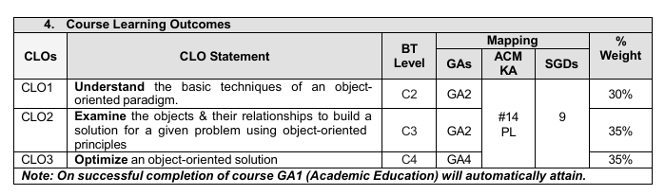
Course Learning Outcomes (CLOs) and Targeted PLOs/GAs:

Slide 7
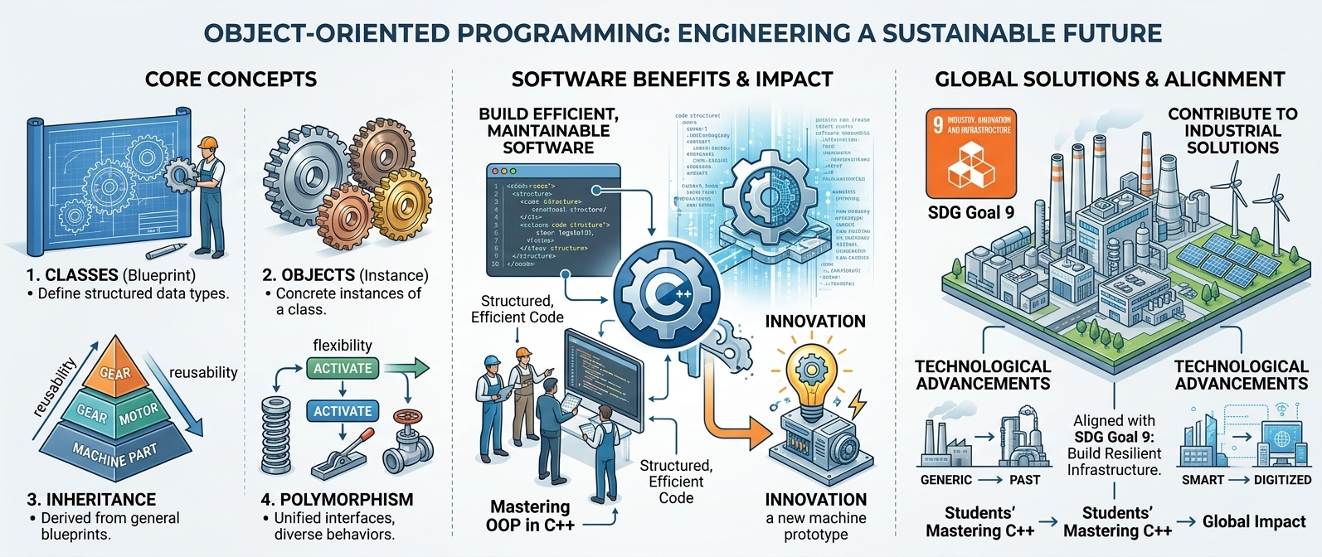
SDG Goal 9: Industry, Innovation & Infrastructure

Slide 8
Recommended Textbooks (C++)
Sr. No. | Book Title | Author(s) | Edition/Publisher/ Publication Year
1. | Object-Oriented Programming. | Robert Lafore. | 4th Edition
2. | C++ How to Program, 10th Edition. | Deitel & Deitel | 10th Edition
3. | Object Oriented Programming. | Asen Rahnev, Nikolay Pavlov, Nikola Valchanov, Todorka Terziev | 5th Edition

Slide 9
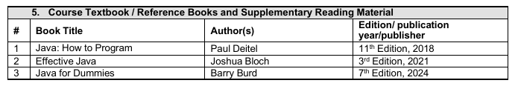
Recommended Textbooks (Java)

Slide 10


C++ OOP Certificate Courses
Course Name: Fundamentals of Object-Oriented Programming in C++
Instructor: Packt
Platform: Coursera
Link: https://www.coursera.org/learn/packt-fundamentals-of-object-oriented-programming-c-b5fxn
What you'll learn
Learn C++ fundamentals, master functions, arrays, pointers, and OOP concepts like encapsulation, inheritance, and polymorphism for dynamic programming proficiency.

Slide 11


C++ OOP Certificate Courses
Course Name: Object Oriented Programming in Java Specialization
Instructor: University of California San Diego, Duke University
Platform: Coursera
Link: https://www.coursera.org/specializations/object-oriented-programming
What you'll learn
Designed for aspiring developers with prior programming experience who want to master object-oriented design to solve complex software problems.

Slide 12


C++ OOP Certificate Courses
Course Name: Object-Oriented Programming Concepts
Instructor: Noel J. Bergman, LearnQuest
Platform: Coursera
Link: https://www.coursera.org/learn/concepts-of-object-oriented-programming
What you'll learn
Learn core object-oriented programming concepts including objects, classes, inheritance, and polymorphism illustrated in Python and transferable to other languages.

Slide 13

Agenda
Introduction
History
OOP Basic concepts
Concluding remarks
OOP
Objects
Classes
Inheritance
Polymorphism
Encapsulation
Abstraction

Slide 14
Introduction

Slide 15
Computer Programming
Computer programming is the process of designing, writing, testing, and maintaining a set of instructions that tells a computer how to perform specific tasks or solve problems.

Slide 16
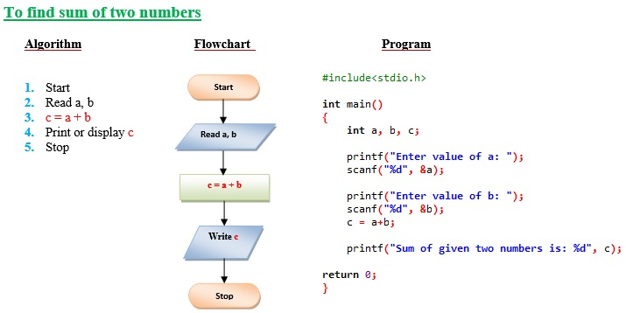
Examples of Algorithm

Slide 17
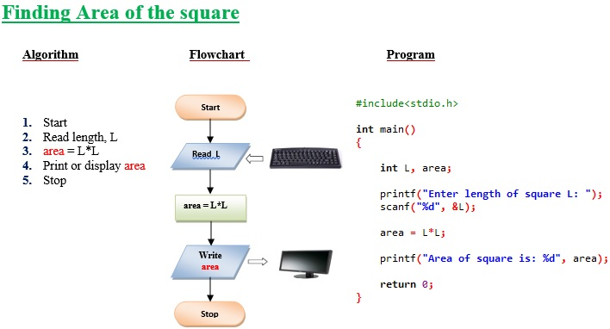
Examples of Algorithm

Slide 18
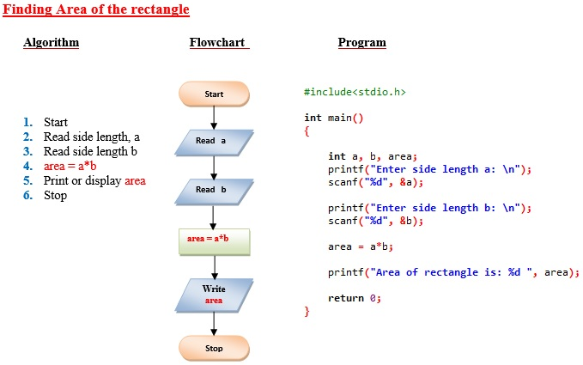
Examples of Algorithm

Slide 19
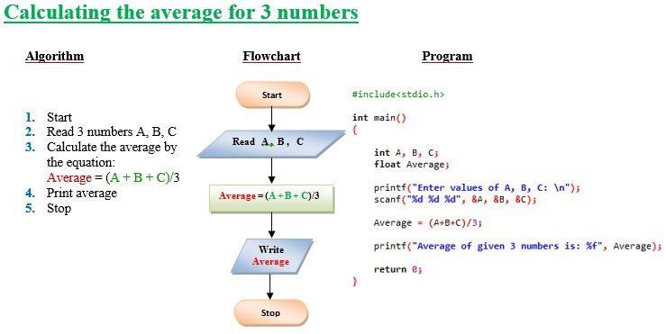
Examples of Algorithm

Slide 20
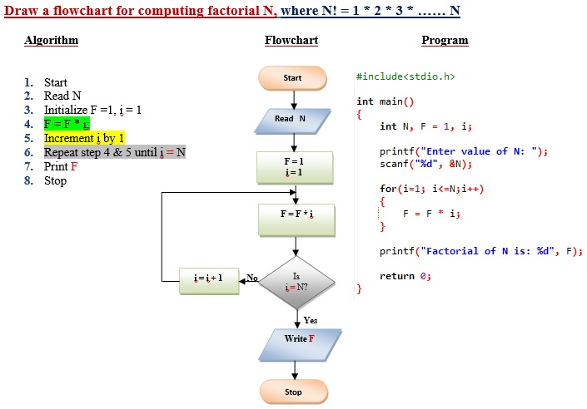
Examples of Algorithm

Slide 21
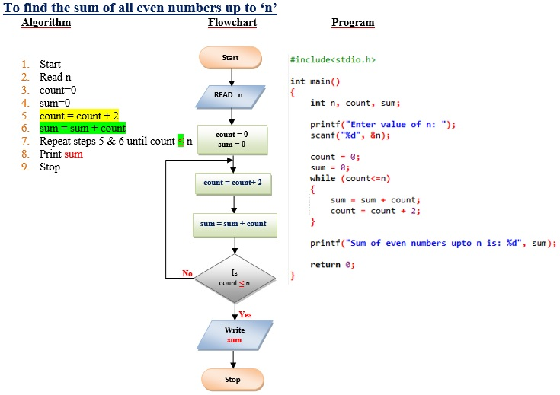
Examples of Algorithm

Slide 22
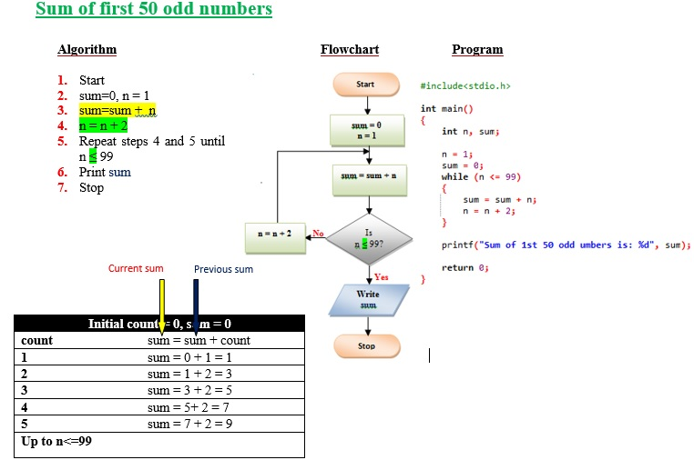
Examples of Algorithm

Slide 23
Examples of Algorithm

Slide 24
History
Early Stage: Computer programming began with machine-oriented instructions that were difficult for humans to understand.
Development Stage: Programming languages evolved to make writing and understanding instructions easier for humans.
Modern Stage: Programming approaches now use concepts such as objects and real-world models to represent and solve problems more naturally.

Slide 25
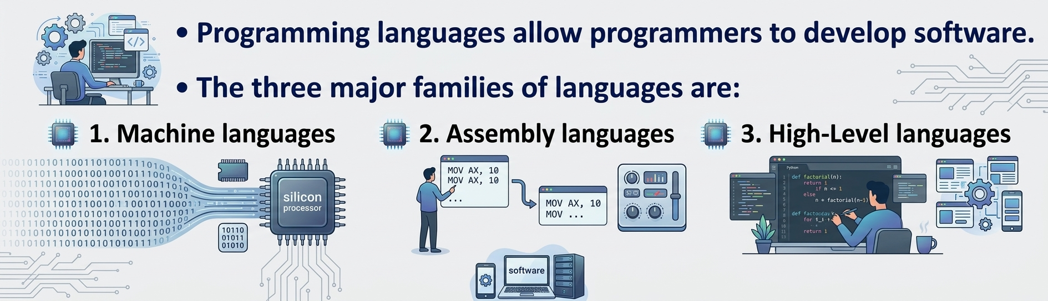

Slide 26
Machine Languages
Comprised of 1s and 0s
The “native” language of a computer
Difficult to program – one misplaced 1 or 0 will cause the program to fail.
Example of code:
1110100010101 111010101110
10111010110100 10100011110111

Slide 27
Assembly Languages
Assembly languages are a step towards easier programming.
Assembly languages are comprised of a set of elemental commands which are tied to a specific processor.
Assembly language code needs to be translated to machine language before the computer processes it.
Example:
ADD 1001010, 1011010
Notes:
Uses assembler

Slide 28
High-Level Languages
High-level languages represent a giant leap towards easier programming.
The syntax of HL languages is similar to English.
    Example:
      grossPay = basePay + overTimePay
    Interpreter – Executes high level language programs without compilation.
Historically, we divide HL languages into two groups:
  Procedural languages
  Object-Oriented languages (OOP)

Slide 29
Procedural Languages
Early high-level languages are typically called procedural languages.
Procedural languages are characterized by sequential sets of linear commands. The focus of such languages is on structure.
Examples include C, COBOL, Fortran, LISP, Perl, HTML, VBScript

Slide 30
Object-Oriented Languages
The focus of OOP languages is not on structure, but on modeling data.
Programmers code using “blueprints” of data models called classes.
Examples of OOP languages include C++, Visual Basic.NET and Java.

Slide 31
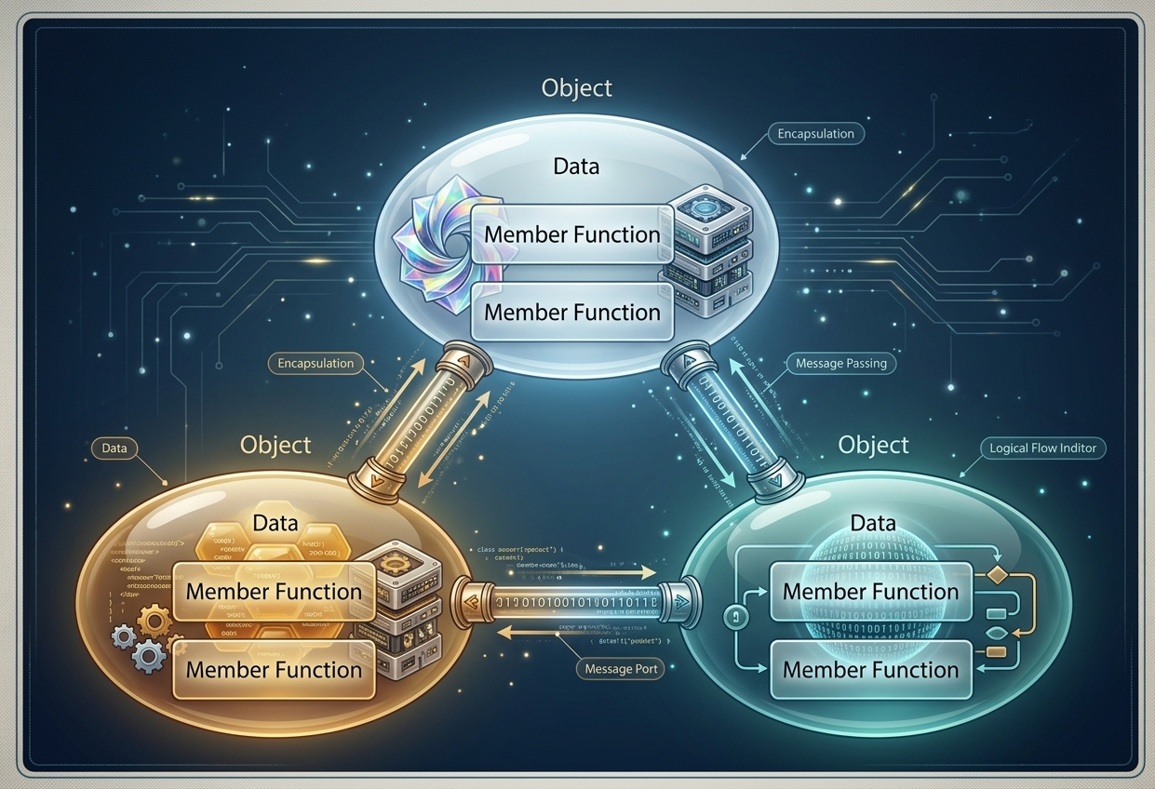
Object-oriented Paradigm

Slide 32
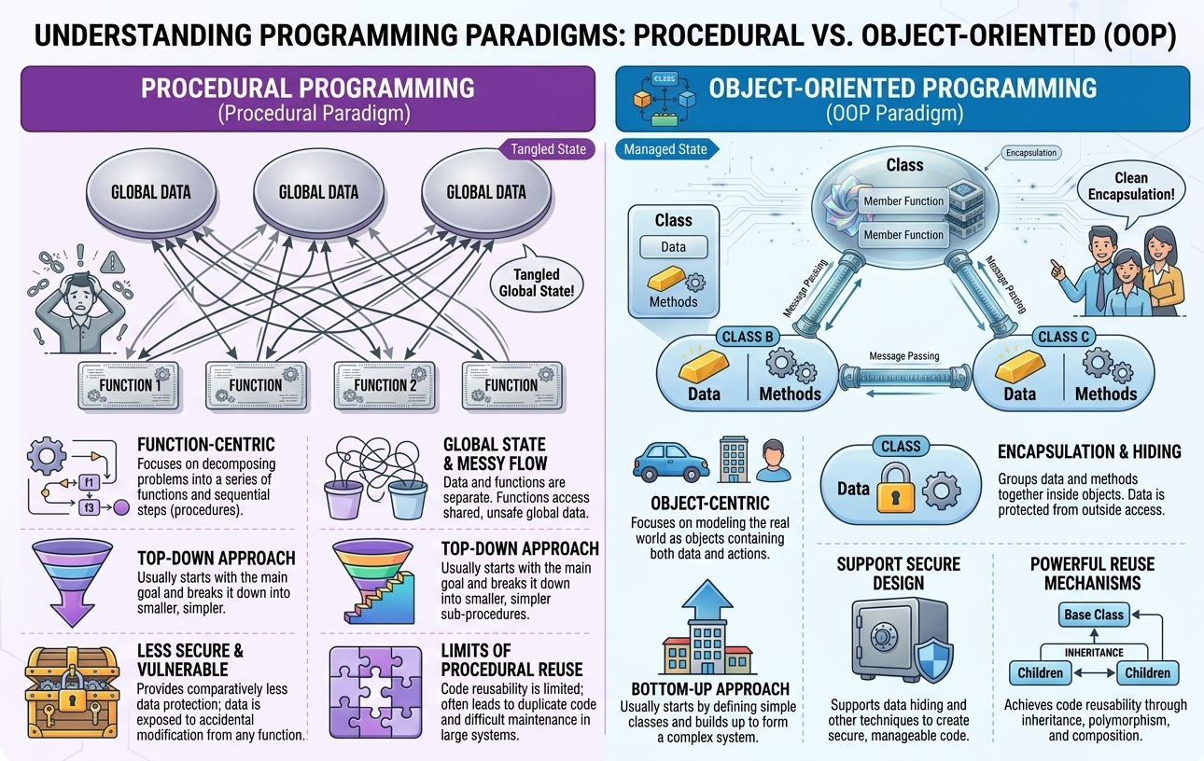

Slide 33
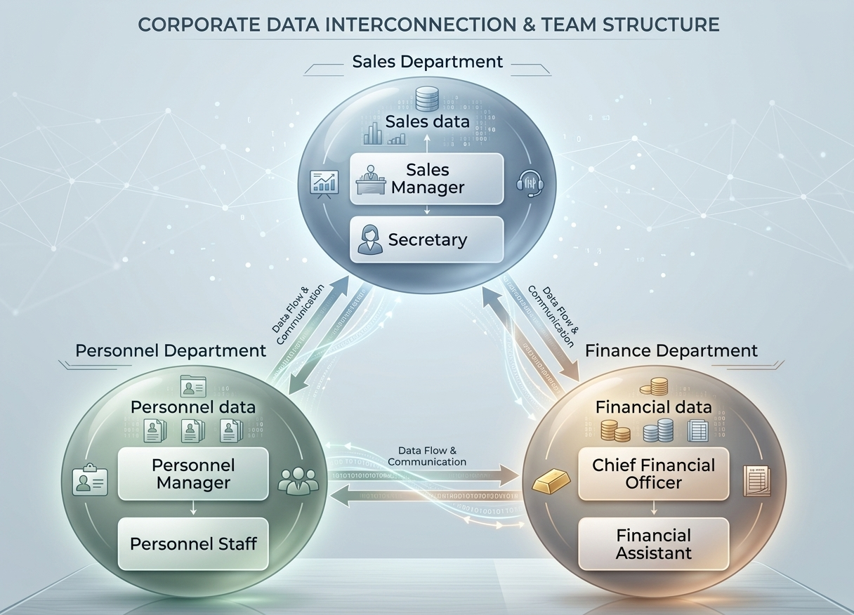
The Corporate Paradigm

Slide 34
Traditional Programming vs Object Oriented Programming
Procedure-Based: Focuses on functions and procedures to solve problems.
Data and Functions: Data and functions are generally handled separately.
Approach: Usually follows a top-down approach to program design.
Data Security: Provides comparatively less data protection because data may be shared among functions.
Reusability: Code reusability is generally achieved through functions.
Traditional Programming: C (primarily procedural)
Object-Based: Focuses on objects and classes to solve problems.
Data and Methods: Data and methods are grouped together inside classes.
Approach: Usually follows a bottom-up approach to program design.
Data Security: Supports data hiding and encapsulation to protect data.
Reusability: Supports code reusability through inheritance, composition, and other OOP features.
Object-Oriented Programming: Java, C++, C# and Python

Slide 35
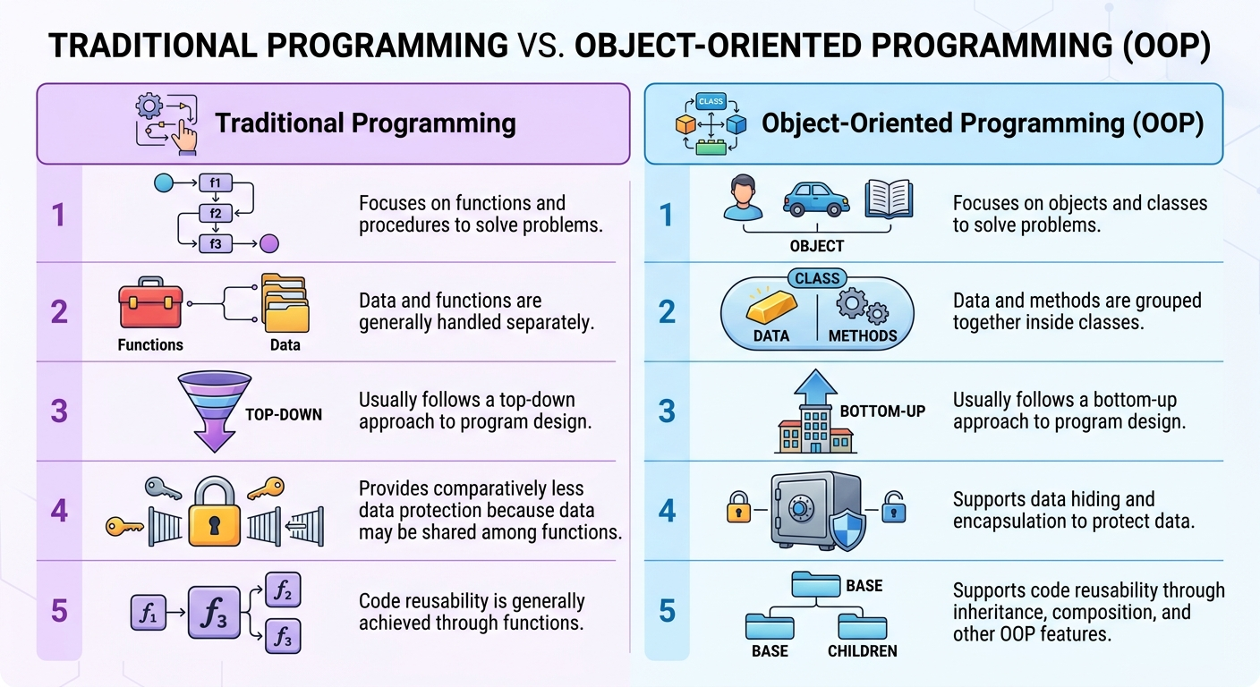

Slide 36
Object Oriented Programming Model
What is a Model?
A model is an abstraction of something real or conceptual. We need models to understand an aspect of reality.
Model Examples
Highway maps
Architectural models
Mechanical models

Slide 37
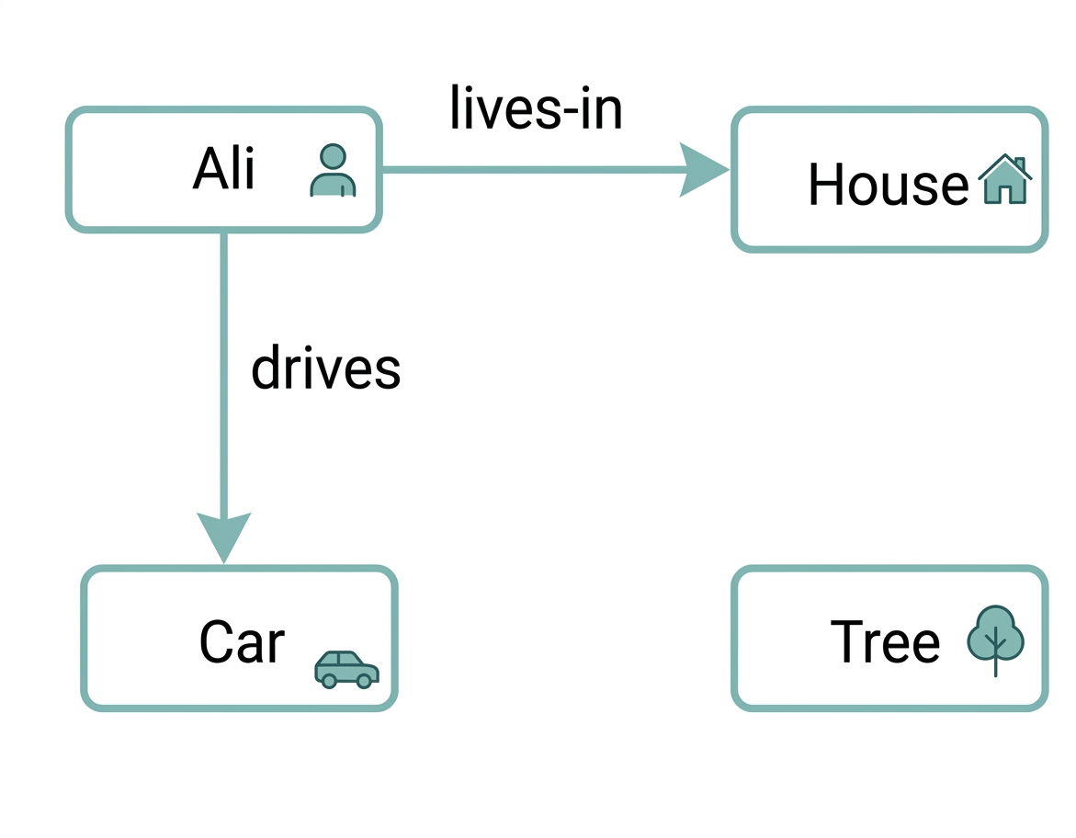
Object Oriented Programming Model
In the context of programming models are used to understand the problem before starting developing it. We make Object Oriented models showing several interacting objects to understand a system given to us for implementation.
Object Oriented Model
Objects:
Ali, Car, House, Tree
Interactions:
Ali lives in the house
Ali drives the car

Slide 38
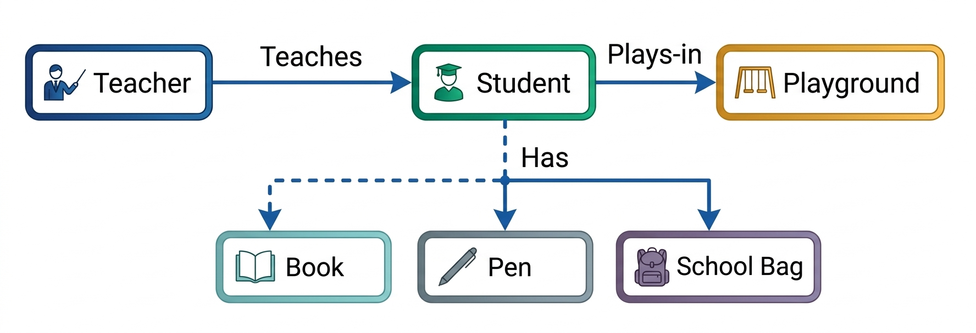
Object Oriented Programming Model
Object Oriented Model (A School Model)
Objects:
Teacher, Student, School Bag, Pen, Book Playground
Interactions:
Teacher teaches Student.
Student has School Bag, Book and Pen

Slide 39
Advantages of OOP
OOP provides a clear structure to programs
Makes code easier to maintain, reuse, and debug
Helps keep your code DRY (Don't Repeat Yourself)
Makes it possible to create full reusable applications with less code and shorter development time

Slide 40
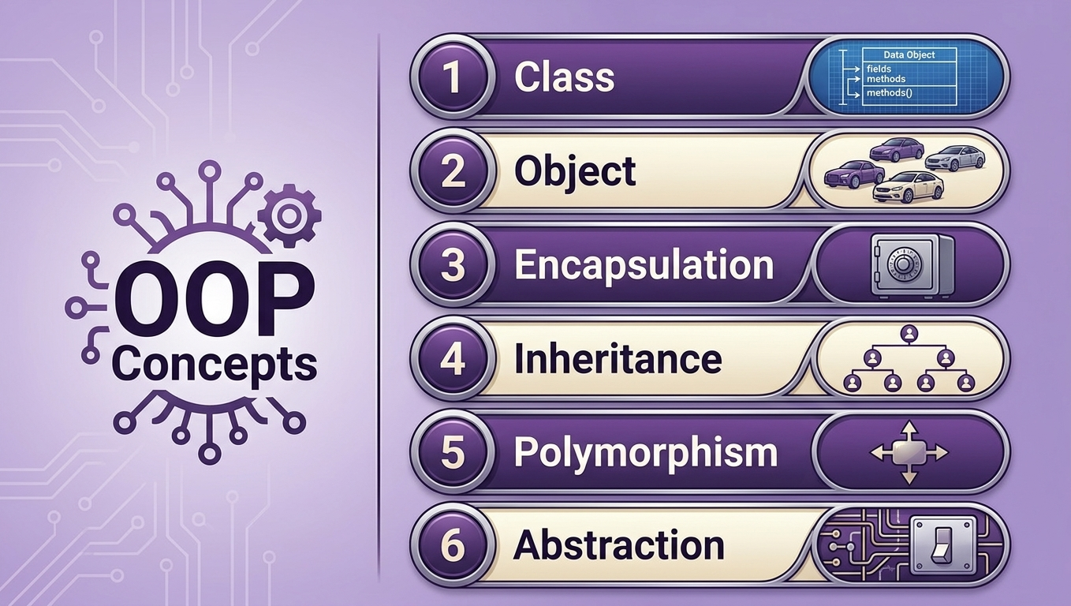

Slide 41
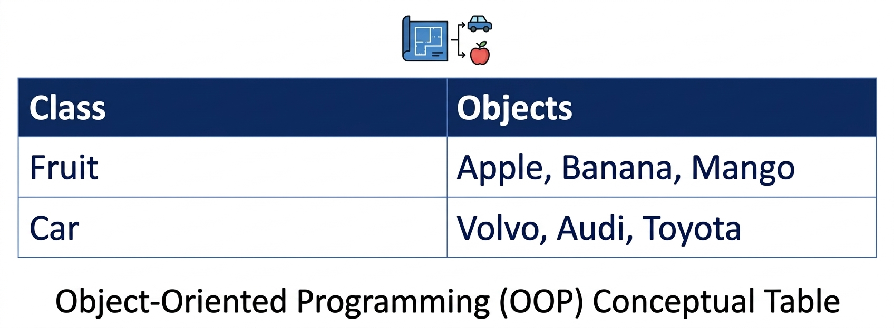
What are Classes and Objects?
Classes and objects are the two main aspects of object-oriented programming.
A class defines what an object should look like, and an object is created based on that class. For example:

Slide 42
Examples of Tangible Objects
Examples of Tangible Objects:
Ali is a tangible object, having some characteristics (attributes) and behavior as given below,
Characteristics (attributes)
Name
Age
Behavior (operations)
Walks
Eats
We will identify Ali using his name.
Car is also a tangible object having some characteristics (attributes) and behavior given below,
State (attributes)
Color
Model
Behavior (operations)
Accelerate
Start Car
Change Gear
We can identify Car using its registration number.

Slide 43
Examples of Intangible Objects
Time is an intangible (conceptual) object
State (attributes)
Hours
Seconds
Minutes
Behavior (operations)
Set/Get Hours
Set/Get Seconds
Set/Get Minutes
We will assign our own generated unique ID in the model for Time object.
Date is also an intangible (conceptual) object
State (attributes)
Year
Day
Month
Behavior (operations)
Set/Get Year
Set/Get Day
Set/Get Month
We will assign our own generated unique ID in the model for Date object.

Slide 44
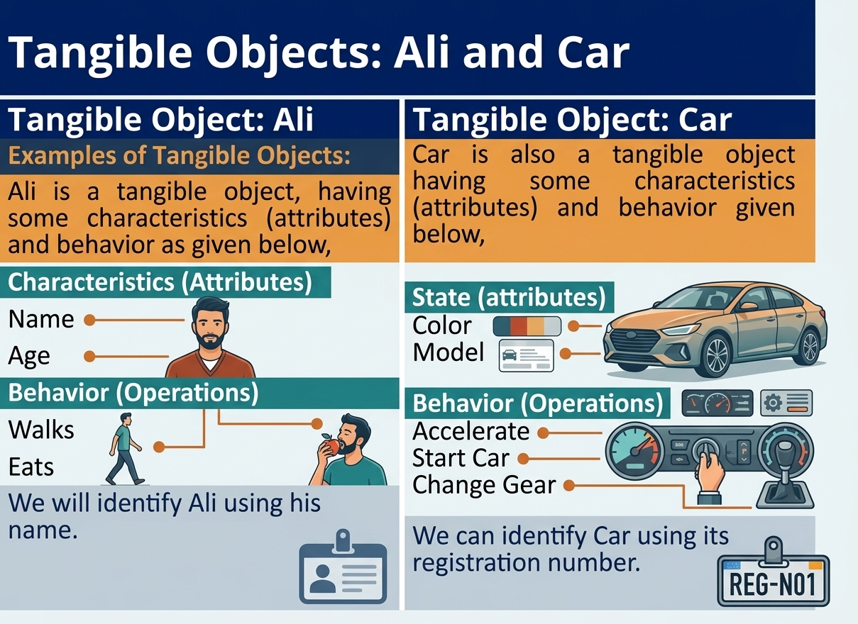

Slide 45
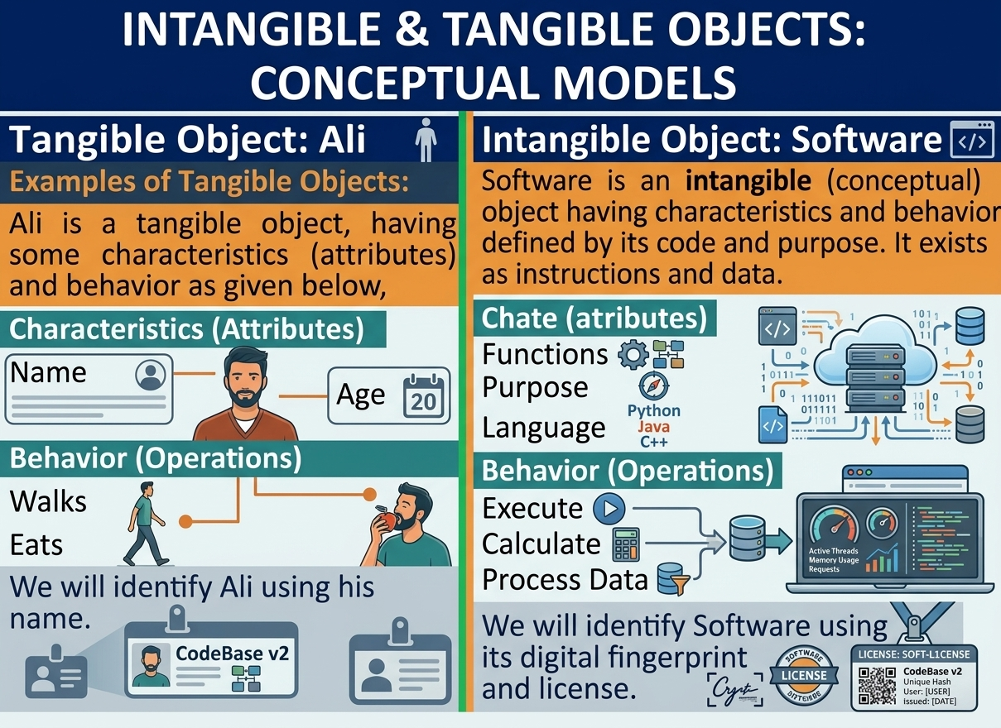

Slide 46

MS TEAMS
CHANNEL
QR CODE

Slide 47
ANY QUESTION ??

